Slide 1






Systematical integration of public single cell datasets pinpoints TLB(T-liked B cell)
Chen-Rui Xia
Gao Lab, Peking University
Mar 22, 2021

Slide 2
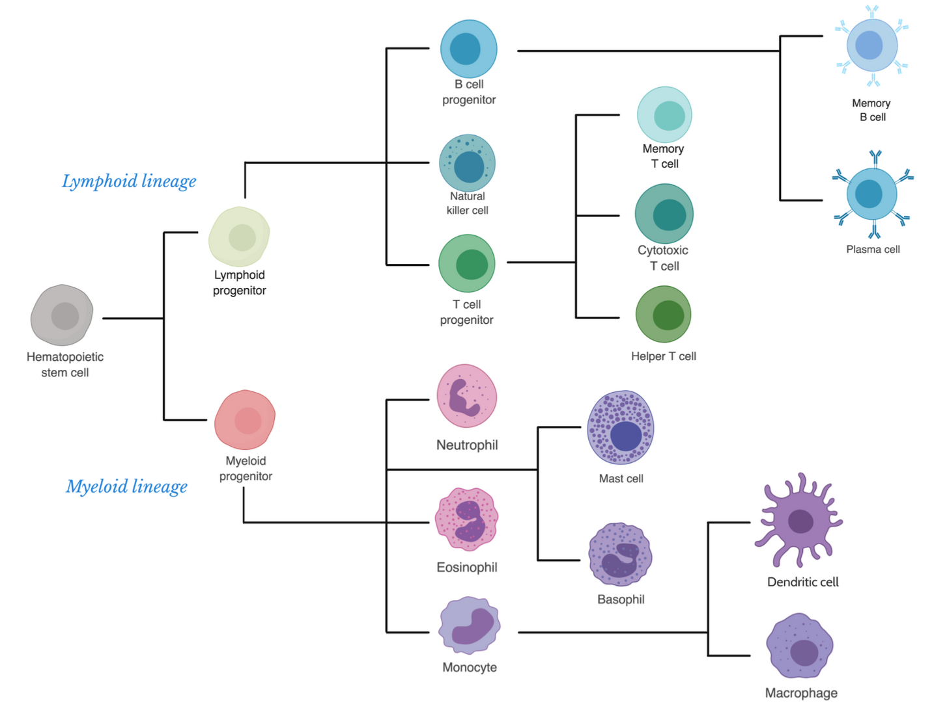
What’s the B Cell?
An important adaptive immune cell
Bethesda (2012) Immunology IV: Clinical Applications in Health and Disease
Notes:
在之前大量的研究中，人们对免疫系统的分化和机制都有了较为清晰的了解，
B cell作为适应性淋巴细胞中的一个重要分支，在机体维持自身稳态和对抗疾病或者外物入侵中发挥着独特而关键的作用。

Slide 3
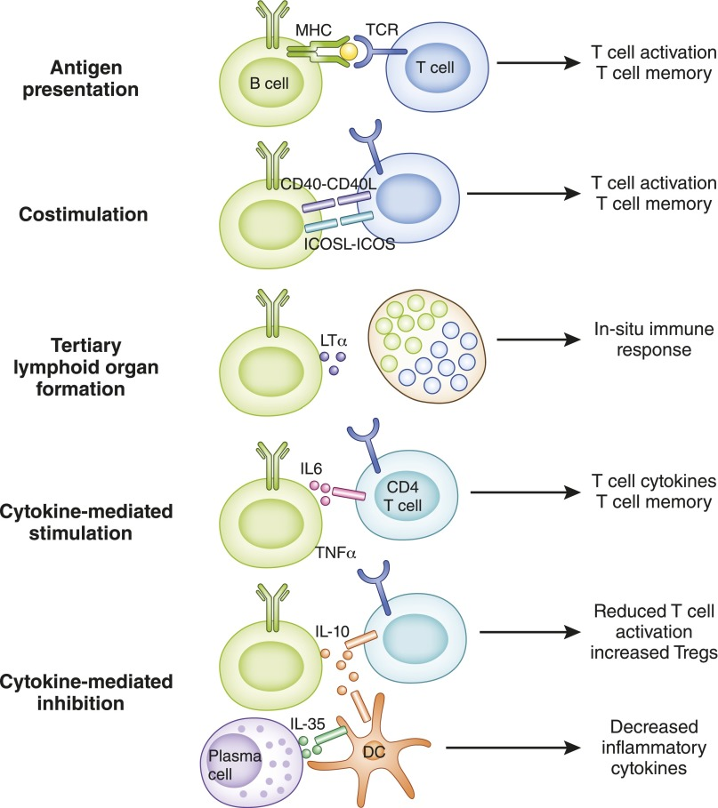
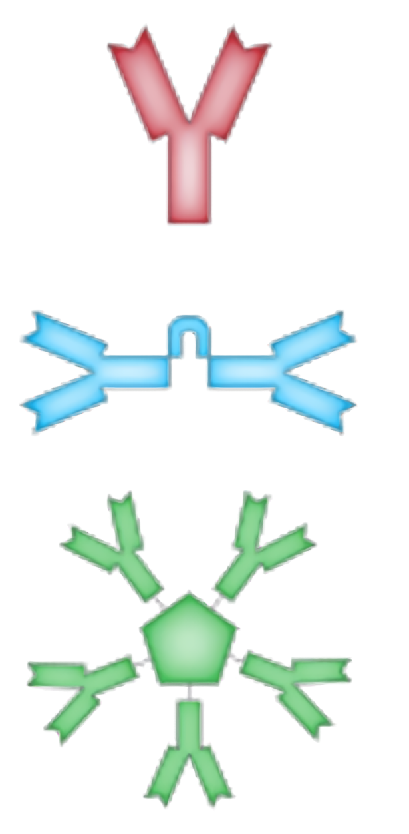
What can B cells do?
Antibody secreting
Cellular functions
Monomer
IgD, IgE, IgG
Dimer
IgA
Pentamer
IgM
William Hoffman et al. (2016) Clin. J. Am. Soc. Nephrol.
Notes:
B cell最特异性发挥作用的方式就是分泌抗体，并且应对不同需求分泌各种亚型的抗体，如IgA，IgG等
此外，作为免疫系统的重要成员，B cell的细胞学方面的作用也绝对不可小视，例如充当抗原呈递细胞，与T 细胞之间的相互激活…..

Slide 4
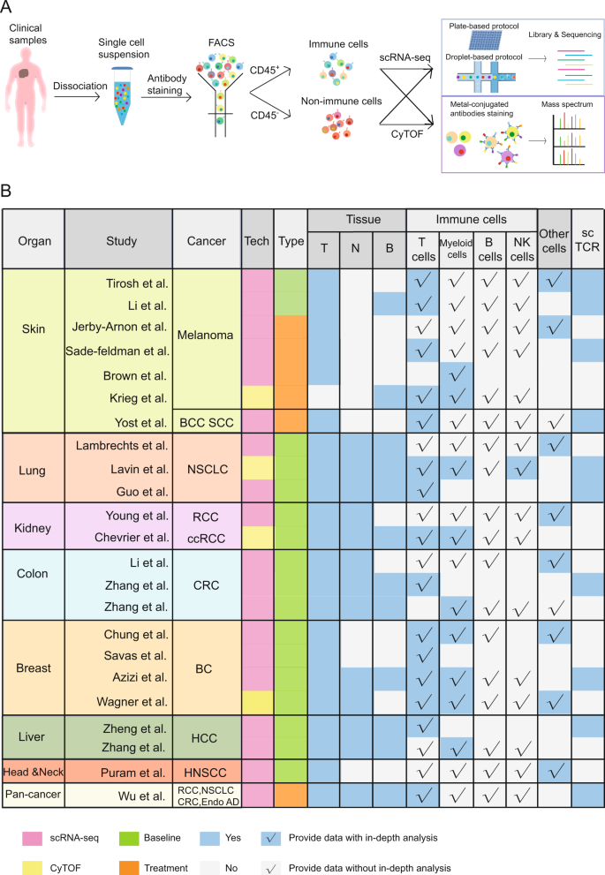
The current neglect of the importance of B cell
For example, in cancer, B cells have always existed widely, but there is a lack of in-depth research
Zhang Y et al. (2020) Cell. & Mol. Imm.
Notes:
然而目前缺乏对B 细胞重要功能的全面认识，例如B 细胞已经被发向广泛存在于多种癌症中，但是一直缺乏对B 细胞功能的系统性研究

Slide 5






















Our motivation
A single cell resolution atlas for B cells in disease and health
UVM
oesophagus
NPC
HNSC
lymph node
blood
BRCA
NSCLC
thymus
lung
LIHC CHOL
ESCC GEJ STAD
spleen
liver
PAAD
CRC
gut
kidney
KIRC
BLCA
bone marrow
BCC
SKCM
MCC
Healthy Human(101)
Patients(467)
Notes:
而我们的目标是构建单细胞分辨率的B 细胞图谱，包含了健康人的多种组织，以及癌症，自身免疫疾病等多种重要疾病，特别的我们目前的数据还包含重要的模式生物小鼠可能会揭示人鼠在B 细胞谱系上的差异
More precise definition and division of the subgroups of B cells
Reveal the unique role of B cell in various diseases

Slide 6
Data analysis workflow
Quality control
Normalization
Cluster analysis
Find marker genes
B cell identification
Extract with meta
Notes:
单细胞测序数据分析的标准流程……

Slide 7
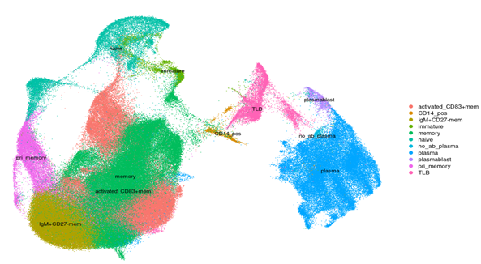
Atlas annotation and identify a non-common B cell type
CD79A
naive
immature
CD3
TLB
plasmablast
plasma
memory
Notes:
我们发现图谱中的绝大多数cluster能够与已知的B cell subtype较好的对应起来，但是我们还发现了一种新的B cell亚群，它的特征是同时表达B cell和T cell的表面marker，如CD79A 和CD3。

Slide 8
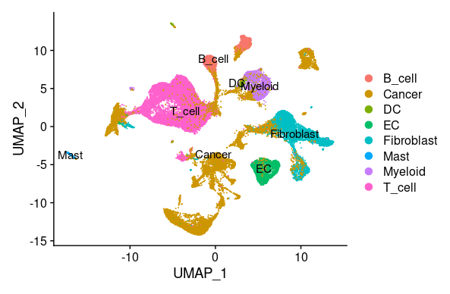
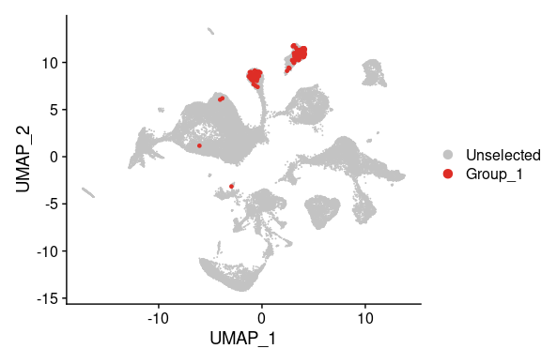
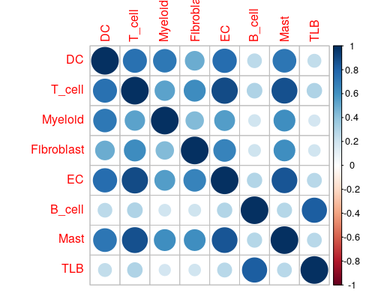
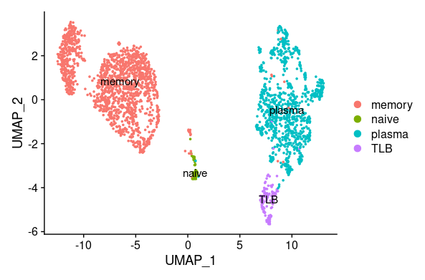
Why name it TLB？
whole immune micro-environment
highlight TLB
re-clustering of B cell alone
spearman correlation in whole transcriptome level
Data from Qian J et al. (2020) Cell Res.
Notes:
为什么叫TLB而不是BLT——与B cell更加相似

Slide 9
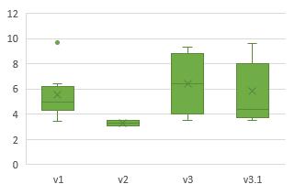
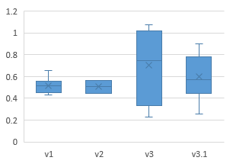
Is it artifact?——TLB existence assessment
1. Find TLB in different cancer/dataset, different sequencing protocol
platform | Dataset | TLB | TLB/B ratio
Smartseq2 | SKCM_GSE72056 | 83 | 13.00%
 | SKCM_GSE120575aPD1 | 21 | 1.26%
 | SKCM_GSE115978aPD1 | 84 | 9.47%
 | NSCLC_GSE127465 | 76 | 1.78%
10x | UVM_Michael | 388 | 15.60%
 | TME_integration | 1502 | 4.29%
 | STAD_GSE134520 | 25 | 1.22%
 | SKCM_GSE148190 | 42 | 6.05%
 | SKCM_GSE139249 | 23 | 6.95%
 | REF_thymus | 291 | 5.70%
 | REF_PBMC | 305 | 4.01%
 | REF_ebibone | 2054 | 3.63%
 | RCC_Ajaykumar | 114 | 5.84%
 | NSCLC_GSE139555 | 588 | 17.90%
 | NSCLC_GSE131907 | 308 | 1.98%
 | NSCLC_EMTAB6149 | 132 | 5.17%
 | MCC_GSE118056aPDL1 | 52 | 9.11%
 | MCC_GSE117988aPD1 | 61 | 31%
 | LUAD_Diether | 242 | 4.65%
 | LIHC_GSE14022810X | 319 | 7.53%
 | LIHC_GSE125449aPDL1 | 36 | 5.60%
 | KIRC_GSE145281aPDL1 | 335 | 7.66%
 | KIRC_GSE139555 | 282 | 3.59%
 | HNSC_Unpublished | 92 | 1.20%
 | HNSC_GSE139324 | 823 | 4.67%
 | ESCC_Ylin | 605 | 3.16%
 | CRC_GSE14677110X | 251 | 2.54%
 | CRC_GSE139555 | 119 | 4.11%
 | CHOL_GSE125449aPD1 | 50 | 10.10%
 | BCC_GSE123813aPD1 | 85 | 0.98%
TLB / all PBMC (%)
TLB / B cell(%)
Notes:
不是测序带来的假象: 在多个测序平台，多种单细胞建库技术，多个实验室的数据中同时存在，并且比例比较稳定

Slide 10
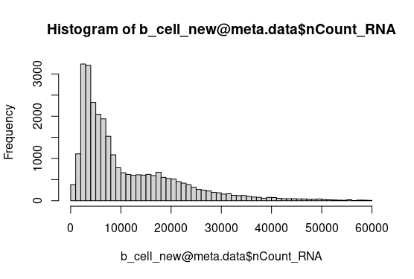
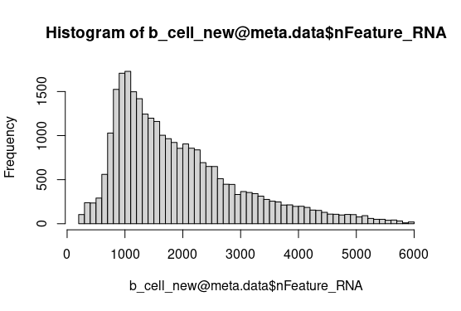
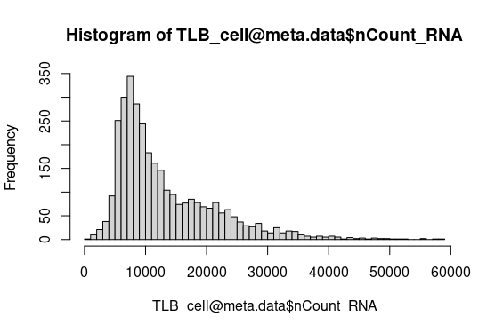
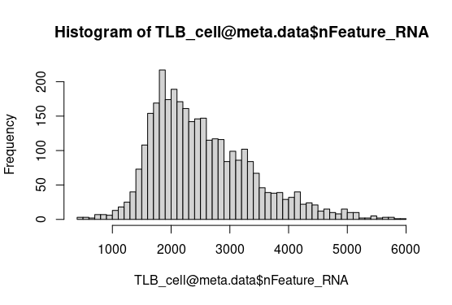
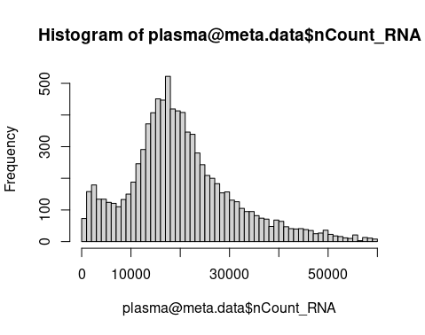
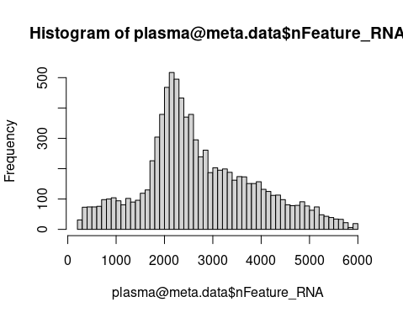
Is it artifact?——TLB existence assessment
2. Exclude the possibility of doublets/ cell fusion
B cell
TLB
plasma
UMIs
Genes
Data from Zhao J et all. (2020) Cell Discovery
Notes:
不是细胞的融合：umi和基因的数量正常

Slide 11
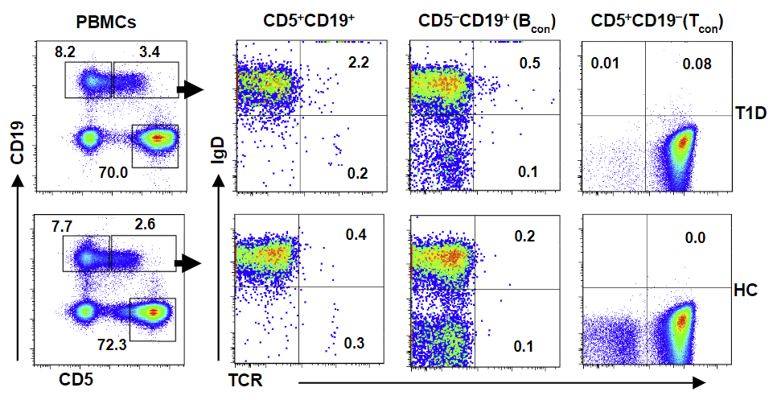
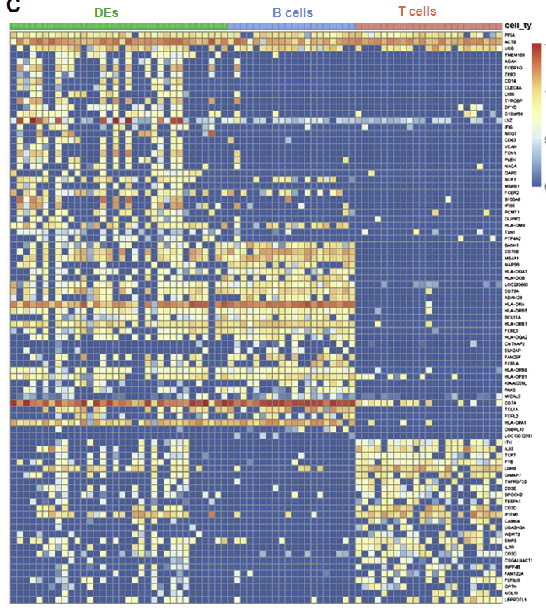
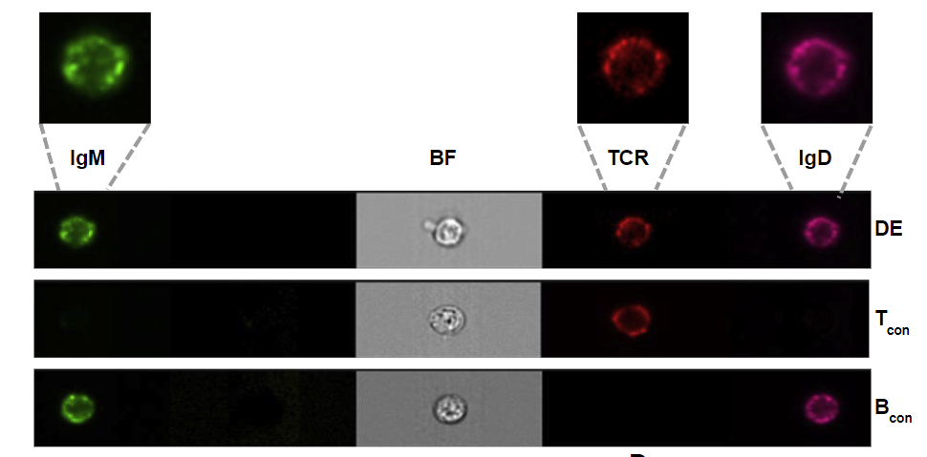
Is it artifact?——TLB existence assessment
“DE cell(X cell)” in T1D and may encode a potent T cell autoantigen
CD5+ CD19+ TCRβ+
Ahmed R et al. (2019) Cell
Notes:
TLB 背景 ：A Public BCR Present in a Unique Dual-ReceptorExpressing Lymphocyte from Type 1 Diabetes Patients Encodes a Potent T Cell Autoantigen

Slide 12
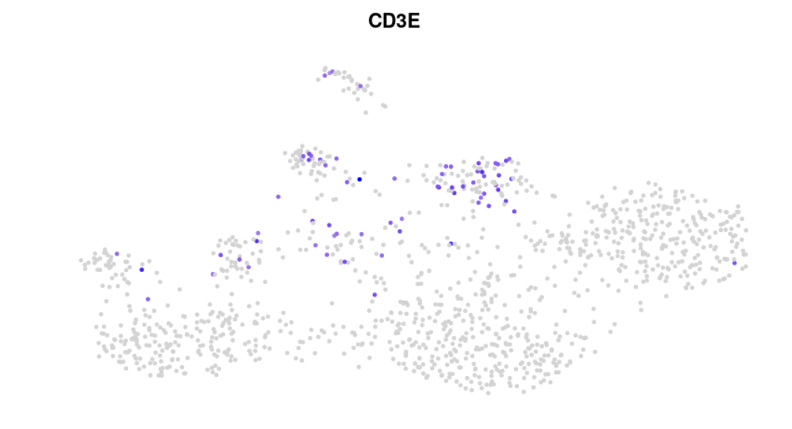
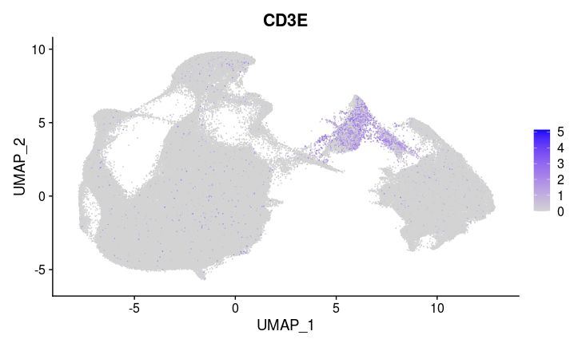
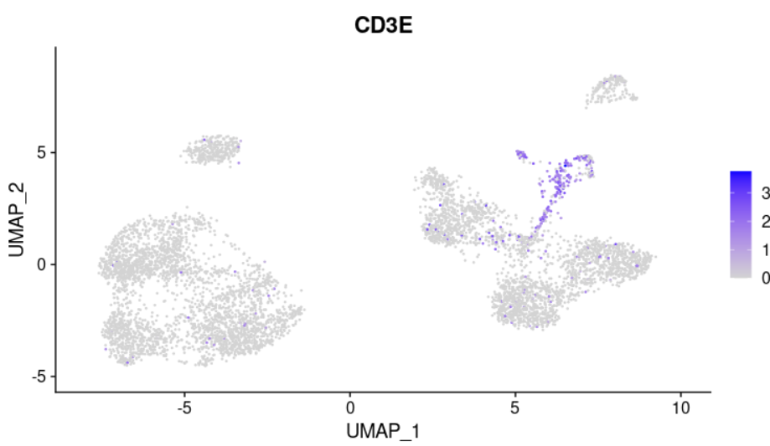
Why we can find TLB?
The rarity of TLB: ~6‰ of immune cell and ~6% of B cell
BRCA_10x 1.2k B cell
B cell atlas 200K B cell
BLCA_10x 6k B cell
Notes:
我们的优势是整合多个数据集，大规模，无偏的研究
数据的整合和挖掘 严格的标准 系统化得到流程，比单个数据集更加深入

Slide 13



In-depth explore of TLB
1. Confirmation of three TLB subtypes
2. Characterizing TLB with high quality, muti-omics single cell data
Transcriptional regulatory network
Surface markers and cell-cell interaction (not finished)
gene expression
surface protein
chromatin accessibility
immune repertoire
B cell atlas
Define TLB
Subgrouping
Characterizing
Notes:
1） 确定TLB 的亚型
2）利用单细胞多组学技术对TLB进行详细深度刻画
a）内部：转录调控网络 I）SCENIC算法
II) single cell ATAC 数据
b）外部：表面蛋白 I) CITE-seq数据分析
II) cell cell interaction

Slide 14
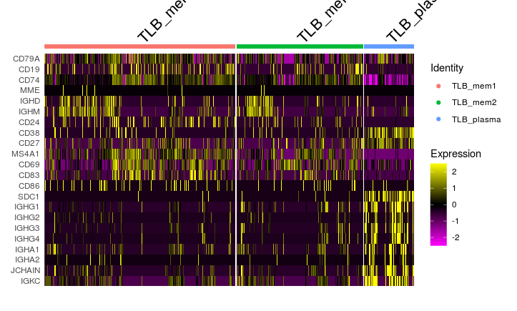
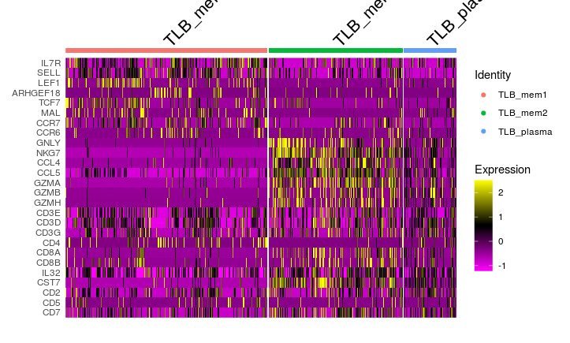
TLB subgrouping
TLB_mem1, TLB_mem2 and TLB_plasma are different in expressing B cell and T cell markers
TLB_mem1
TLB_mem2
TLB_plasma
memory B markers
plasma markers
helper T markers
cytotoxic T markers
Notes:
不同亚型TLB 的特点

Slide 15
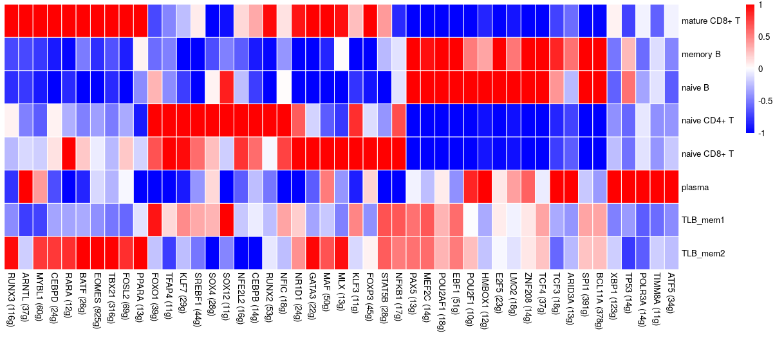
Transcriptional regulatory network——TF activity
By calculating the TF activity(not expression). We find TLB have lower activity in some B cell key TFs such as EBF1 and PAX5,but have higher T cell specific TFs activity, and TLB_mem1 and TLB_mem2 have differences too.
RUNX3
TBX21
RUNX2
GATA3
STAT5B
PAX5
EBF1
BCL11A
POU2AF1
Notes:
SCENIC的原理，基于随机森林找到基因与转录因子的共表达，motif富集来剪枝 AUC 得到每个cluster的打分
TLB 在关键T 和 B 转录因子上的特点

Slide 16
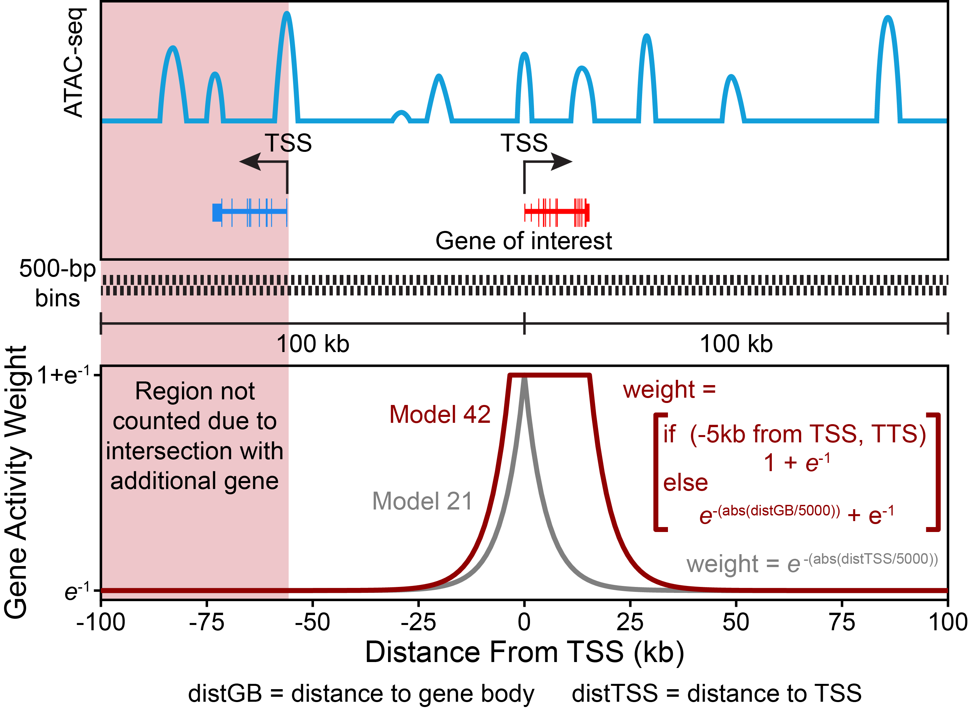
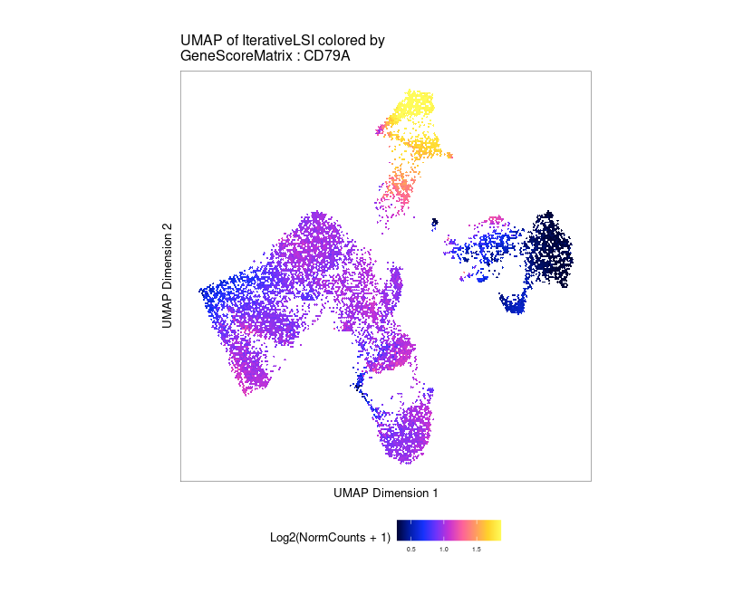
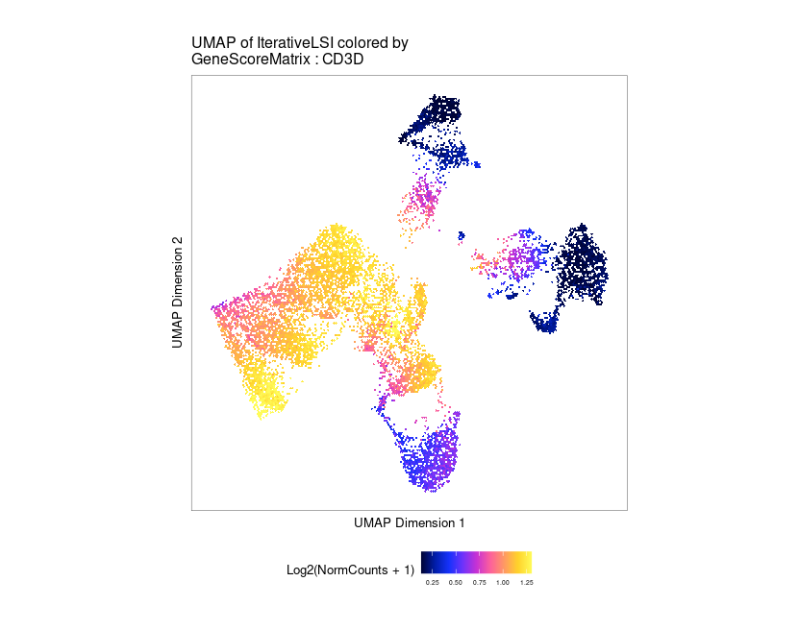
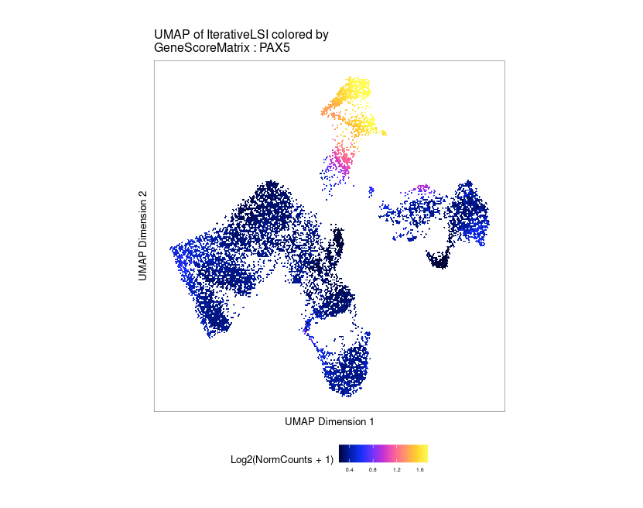
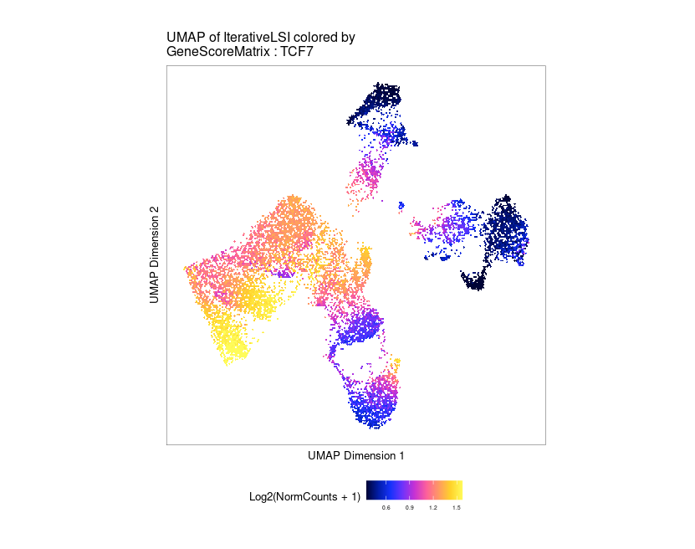
Transcriptional regulatory network——chromatin accessibility
CD79A
CD3D
B cell
TLB
T cell
Granja et al.(2021) Nat. Gen.
PAX5
TCF7
Show how to calculate the GeneScore from the original peak
TLB cells can be detected at T-B boundary by scATAC data by their intermediate transcriptional activity on some T/B markers.
Notes:
single cell atac

Slide 17
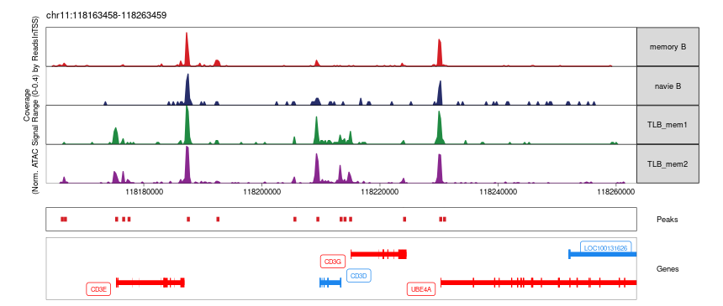
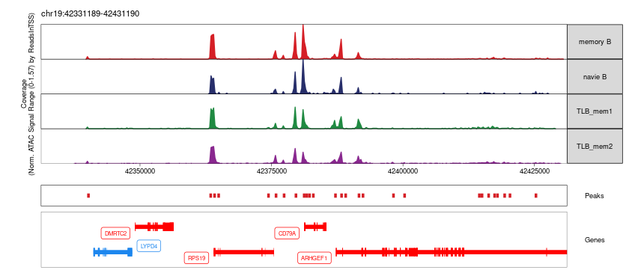
Transcriptional regulatory network——chromatin accessibility
Verification the correlation between GeneScore and peak
CD3 gene group
CD79A
Notes:
pseudo-bulk

Slide 18
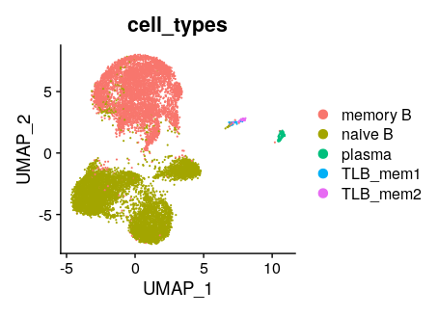
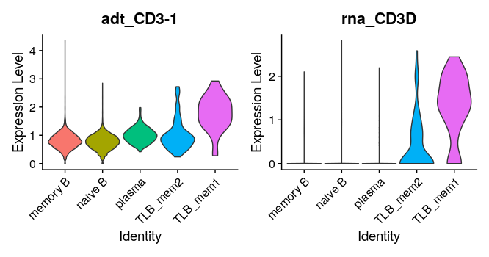
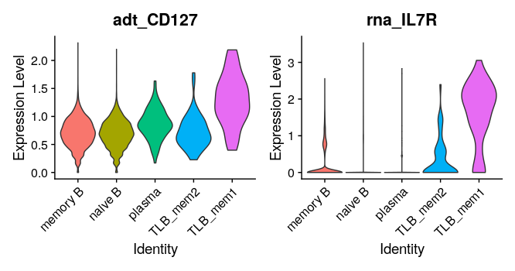
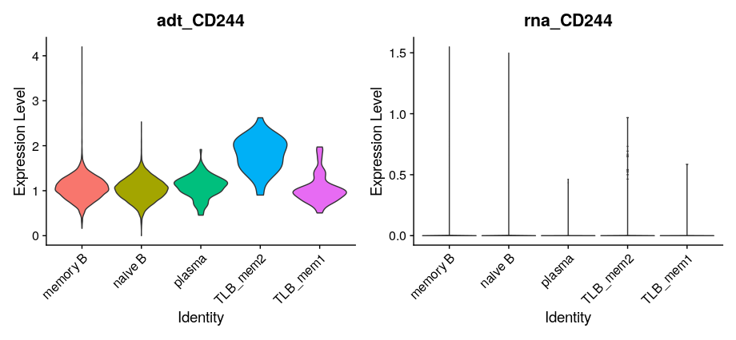
Surface protein
RNA-based clustering
TLB_mem2
TLB_mem1
TLB mem1 markers
TLB mem2 markers
Note: according to the standard protocol, the noise of cite-seq ADT is not removed. CD3 protein should not exist in B cells.
Notes:
表面蛋白进一步证实TLB的存在性，以及TLB_MEM和TLB_mem2的区别

Slide 19
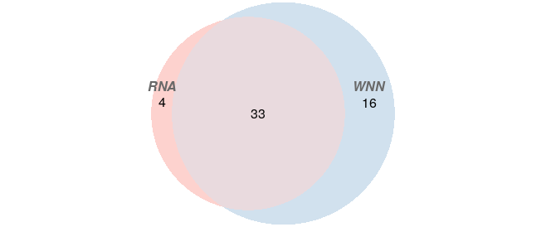
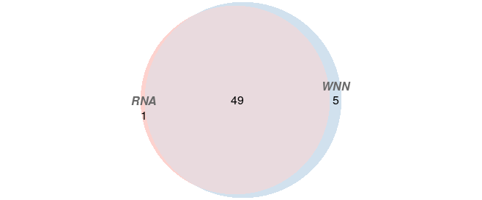
Surface protein
WNN results are highly consistent with RNA-based results
TLB_mem1
TLB_mem2
Cell overlap between RNA-based and WNN clustering
Notes:
WNN 结果与之前的一致性

Slide 20
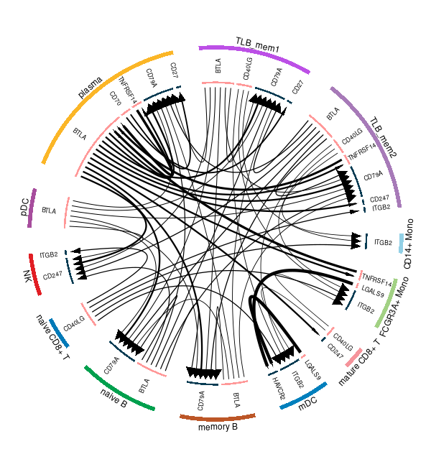
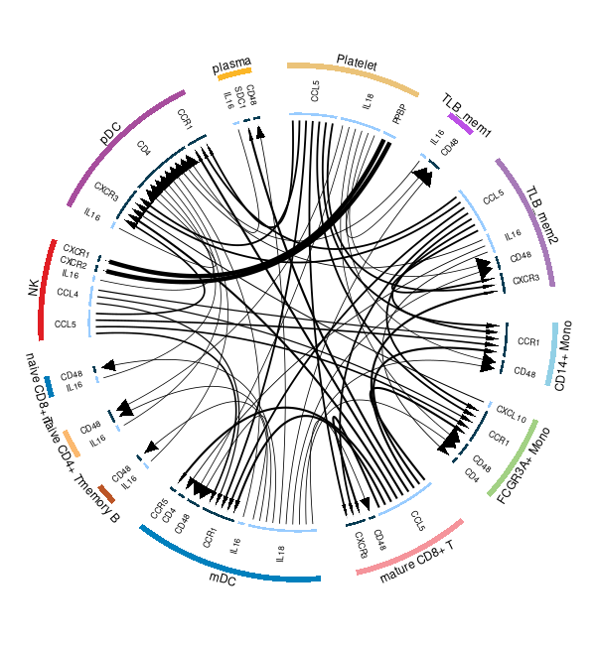
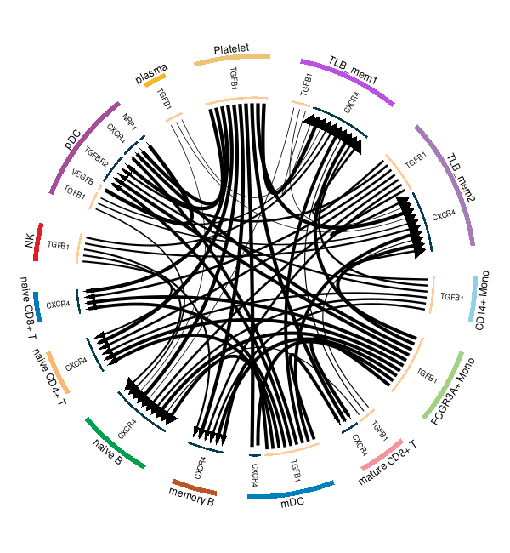
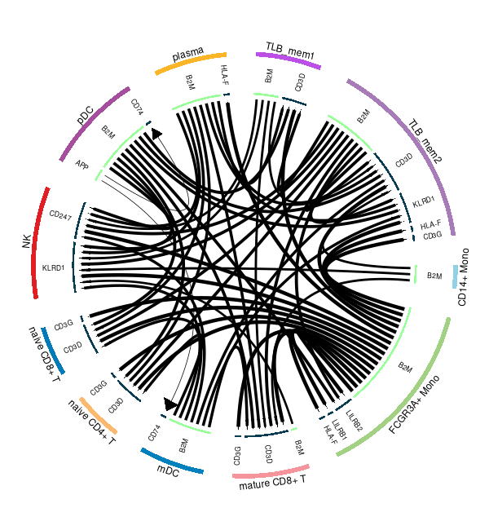
Cell-cell communication
Plot of statistically significant cell-cell communications between TLB, T, and B cells
check points
cytokine
growth factor
other
Notes:
1)外圈是细胞类型 2)里圈是受配体名称 3)从A指到B的箭头代表A是配体，B 是受体 4)粗细代表通讯的密集程度
强调checkpoint有immune checkpoint
Other是其配受体

Slide 21
What can we infer from our results?
TLB
shared markers
shared markers
IL7R
SELL
LEF1
TCF7
CCR7
…
TLB_mem1
TLB_mem2
CD244
TBX21
IFNG
CST7
GZMA
CCL4
CCL5
IFNG
…
helper T
ID2
cytotoxic T
Group 2
Group 1
ILC
*ILC: Innate lymphoid cell
Notes:
TLB与ILC（先天性淋巴细胞）的镜像关系

Slide 22
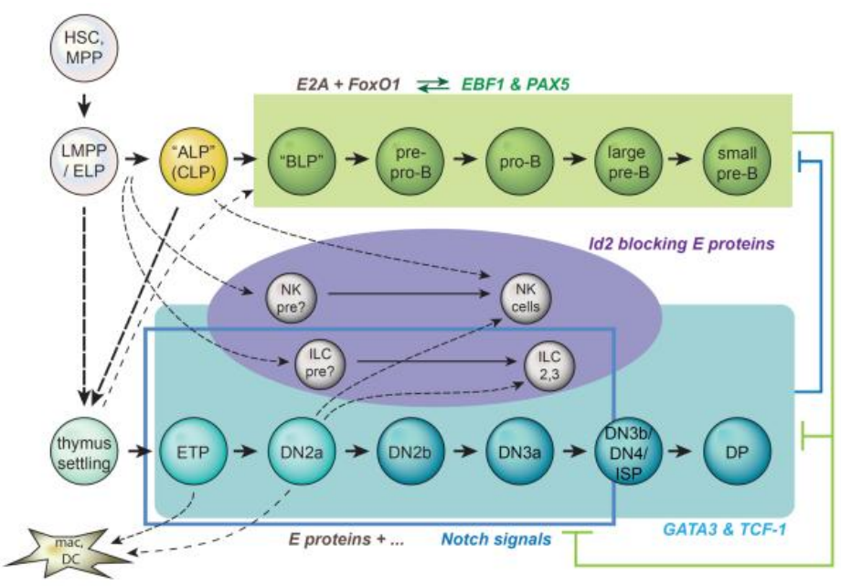
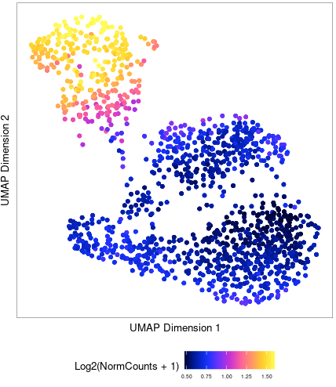
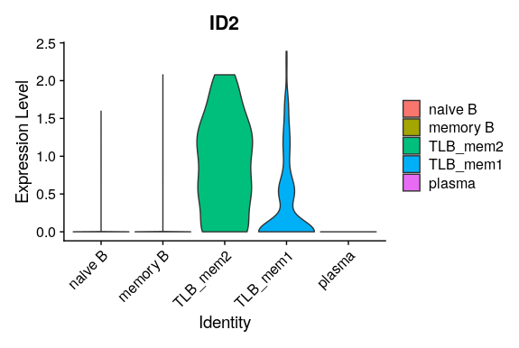
Role of ID2(Inhibitor of Differentiation 2)
Is ID2 the key transcription factor leading to the emergence of TLB?
When and what cell embarked on the developmental path of TLB ?
chromatin
accessibility
RNA expression
Ellen V Rothenberg (2014) Annu. Rev. Immunol.
NOTE: this is the model in mouse
T cell special module(Notch) + ID2 → ILC
B cell special module(EBF1,PAX5) + ID2→TLB
The ILC lineages of lymphocytes depend not on E protein activity but on the neutralization of E proteins by Id2 in order to develop…None of these correspond to “innate B cells” – it appears that the B cell program has too direct and intimate an involvement of E proteins in every aspect of cellular function to possess an “innate” equivalent.
Notes:
对TLB可能来源的猜想（类比ILC的来源）

Slide 23
TLB and SLE

Slide 24
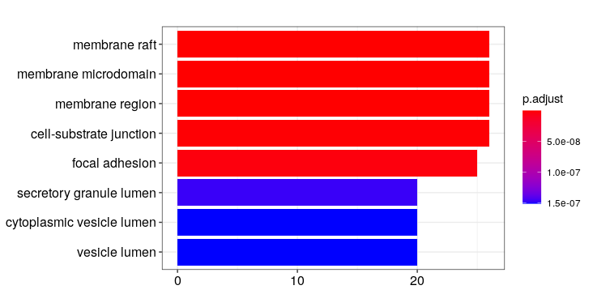
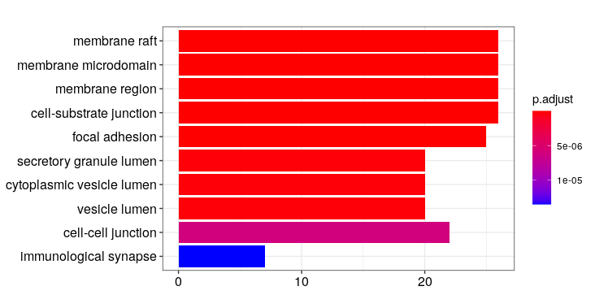
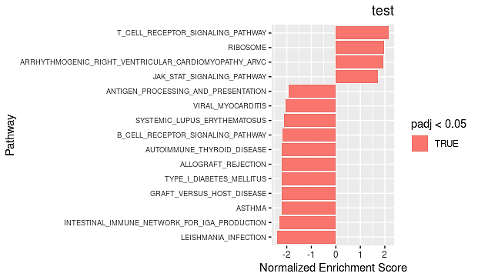
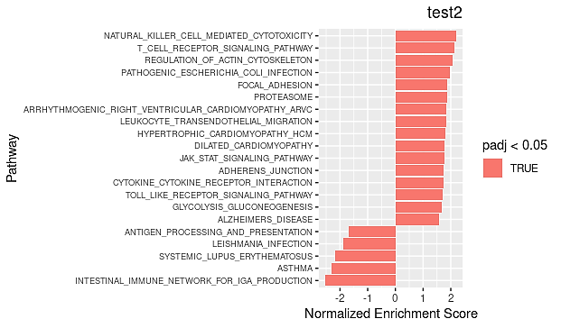
Disease association(SLE)
Pathway enrichment give us some hint that TLB_mem1 and TLB_mem2 are functionally different but both related to autoimmune diseases
TLB_mem1
TLB_mem2
GO enrichment (BP)
GSEA enrichment
Notes:
最后，我们对TLB的功能做了初步的推测
发现在GSEA富集中 TLB两种亚型均富集到了TLB相关的通路上

Slide 25






Higher throughput screening framework
GEO ENA …
single cell expression matrix
key words
searching &analysis
algorithm in HPC
marker genes
detail report
(Internal evaluation phase, by Ding Yang)
Notes:
大规模搜索TLB的计算框架，由丁阳师兄在开发

Slide 26



Background research: single cell & SLE
2017
1,584 cells
2019
~19,200 cells
2020
~350,000 cells
Notes:
单纯堆叠大量单细胞数据可能对发高分文章帮助不大，找到好的生物学问题可能更加关键

Slide 27






Literature Introduction
1
3
2
4
Djamel Nehar-Belaid et al.(2020) Nat. Imm.
Notes:
1 单细胞常规流程，得到SLE PBMC的图谱
2 将已知的SLE相关基因向图谱中不同细胞类型富集
3 将2中显著与SLE相关的细胞类型单独拿出来详细研究
4 依据2，3的结果对患者分层，并与SLEAID得分的结果比较
结论：文章是标准的单细胞套路文章，分析中规中矩，但是没有什么“创新型”结论，文章resource的价值大于analysis的价值

Slide 28




SLE single-cell PBMC data analysis: public data
Part of the results of routine single cell analysis pipeline
PBMC atlas of SLE and control
Disease
Cell markers
Ratio of cell types
Data from Djamel Nehar-Belaid et al.(2020) Nat. Imm.
Notes:
我们对文中中数据的分析

Slide 29




SLE single-cell PBMC data analysis: public data
TLB in this dataset
TLB_mem2
TLB_mem1
CD3D expression in SLE plasma has increased significantly, but we did not cluster TLB_plasma separately because limited cell numbers
Notes:
每个病人测序的深度不够

Slide 30




SLE single-cell PBMC data analysis: preliminary experiment
health people(10x official dataset)
SLE patient (Internal data from PUMC)
Clustering
Clustering
Cell type annotation
Cell type annotation
Notes:
协和SLE预实验数据，并在我们的数据库中选择了一例10x相同测序技术的健康样本作为对照（但应该是欧美人种）

Slide 31




Disease association(SLE)
Health people TLB subtype distribution
Notes:
SLE和健康人中B 细胞比例以及TLB比例的变化

Slide 32





Disease association(SLE)
BCR repertoire difference between the SLE patient and a health people
All B cell BCR distribution
Unique BCR distribution
Clonotypes
CDR3 length distribution
Notes:
bcr of SLE and control

Slide 33





Disease association(SLE)
TCR repertoire difference between the SLE patient and a health people
All T cell BCR distribution
Unique TCR distribution
Clonotypes
CDR3 length distribution
Notes:
tcr of SLE and control

Slide 34






Disease association(SLE)
TLB immune repertoire difference between the SLE patient and a health people
BCR of TLB
TCR of TLB
Notes:
TLB bcr and tcr

Slide 35



Disease association(SLE)
TCR and BCR distribution of different TLB sub types in SLE patient
TLB_mem1
TLB_mem2
TLB_plasma
Notes:
一件非常有趣的事情是3种TLB亚型在TCR 和BCR中的分布各有特点
之后会通过更大队列的数据（公共）来证实这个结论

Slide 36
Highlight
We integrated large-scale, multi-resource scRNA-seq data to profile an unbiased B cell transcriptome atlas at single cell resolution
We pinpointed the pervasive existence of an understudied lymphocyte ——TLB (T-liked B cell), and subgroup TLB into three sub-types
We revealed the regulatory network inside TLB and molecular markers on the surface via single cell multi-omics data (RNA-Seq, ATAC-Seq, VDJ (TCR/BCR) sequencing, surface protein)
We discovered that the proportion of TLB has risen considerably in a SLE patient with a clear enrichment in BCR clonotypes, suggesting that TLB maybe a biomarker or therapeutic target of SLE

